Slide 1
The Electricity Sector in Mozambique
An Analysis of the Power Crisis and its Impact on the Business Environment
[Amilcar Cipriano & Colin Waugh]
[March 2015]

Slide 2
Summary
Underplanning for Growth
Policy focus on Grid Extension
Generation, maintenance, transmission lagging:
Load Shedding, Blackouts
Urgent need for diversification, infrastructure
27% Administration, T & D Losses
Uneconomic tariff for Investors

Slide 3
Study Goals
Raise public awareness of:
The national energy deficit
The challenge of meeting growing demand ahead of a rapid development phase in the natural resources sector.
Contribute to the discourse around:
The role of the State; the need to stimulate investment
Suggesting policy measures for urgent implementation

Slide 4
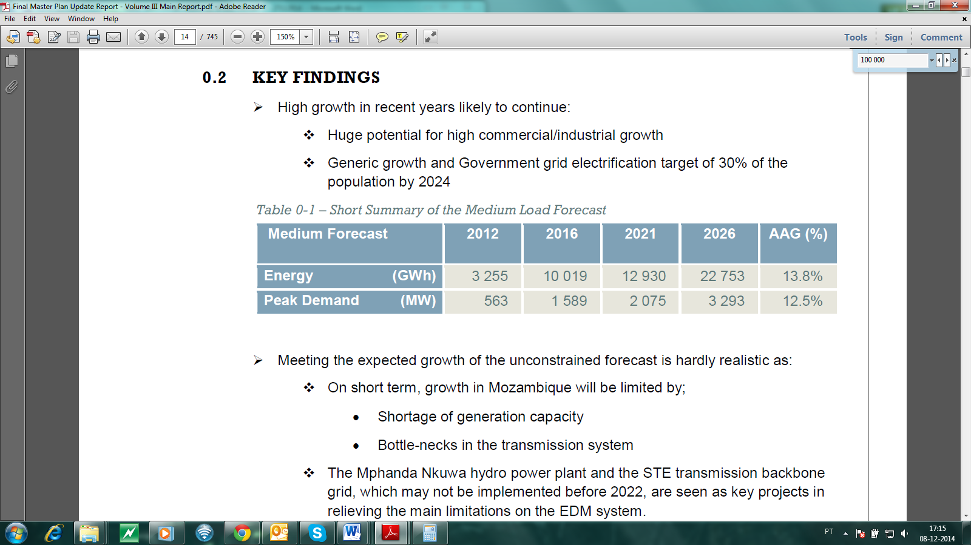
Mozambican National Electric Power Network: Medium Load forecast: Medium Load forecast

Slide 5
Statement of the Problem
Load exceeds available capacity, giving rise to excess power imports, from SAPP, IPPs at cost in excess of tariff
Urgent need to promote the construction of additional and alternative sources of power to create transmission infrastructures and
Deliver power to load centers with cost effective rates
Implement measures aimed at stimulating new investment, achieving efficient supply.

Slide 6
Electricity Supply 2013: Dominance of HCB
CLICK TO ADD BREAKER SLIDE TITLE

Slide 7
Evolution of the Power Matrix
Commercial operation of HCB – began 1975 contributing significantly to the load up to 1981 when war disrupted generation
EDM thermal generation gradually diminished while imports dominated until 1992 Peace Accords
Only in 2012 came the construction at Gigawatt Park/AGGREKO in the Ressano Garcia area

Slide 8
Cumulative Consumption by Source, 1955-2012

Slide 9
Future Generation Projects
New supply from the north continues to exploit Hydropower (Mphanda Nkuwa, Cahora Bassa, Lurio etc)
Coal will continue to play a role in the centre: Moatize, Benga, Nkondezi
Thermal Power burning natural gas will play a major role in the south (Maputo and Ressano Garcia areas)

Slide 10
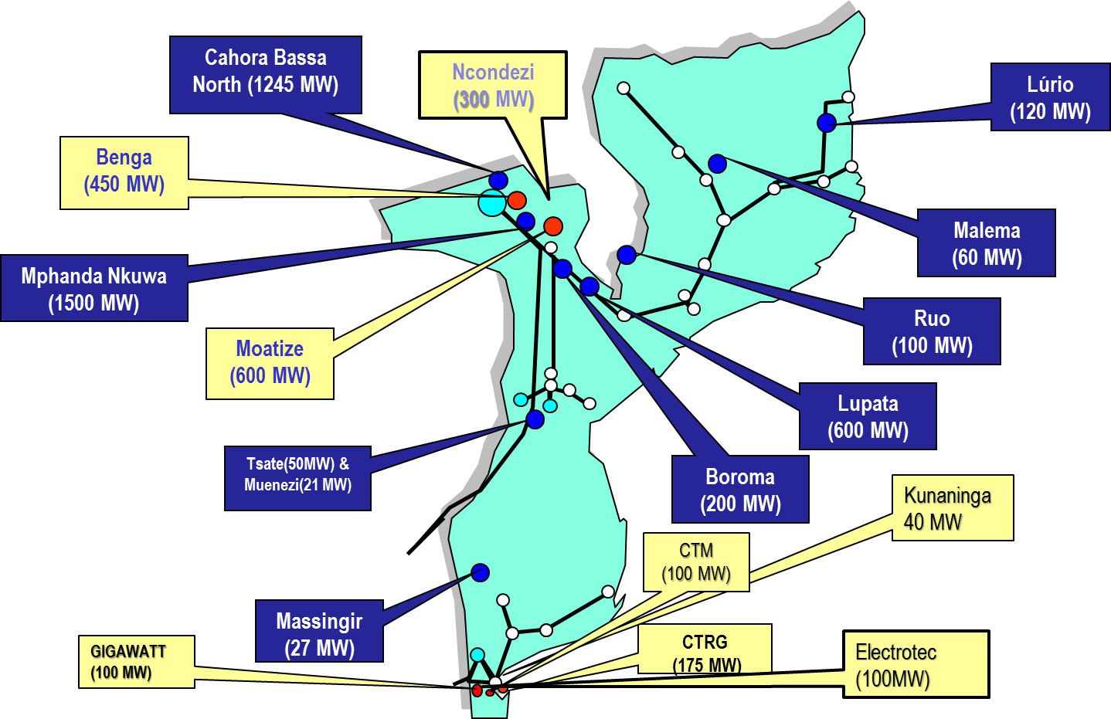
Generation projects (Hydro & thermal) by location

Slide 11
Generation projects under implementation

Slide 12
Projects Proposed and Underway
Chicamba and Mavuzi Power plants rehabilitation
Reinforcement of several substations in the Northern grid
New 275 KV line from Ressano Garcia to Macia
New 400 KV from Caia do Namialo

Slide 13
International Initiatives
Kenya: partial public sale of shares in KenGen, national power gen company
By 2013 seven IPPs generating 20% of total
Nigeria: Grid only delivering 5 GW in 2013 to country of 170m; 25GW private generation
Major overhaul of industry: most generation and distribution privatized, heavy local banking sector support; bottlenecks persist

Slide 14
Discussion & Analysis
Slow pace of regulatory, legislative reform
Heavy price paid for policy of subsidized universal tariff, ignoring cost-benefit basis
Unbundling of ownership, management of Generation and Distribution – PPAs
Accelerated Development Zones: flexible adoption of existing incentive mechanisms

Slide 15
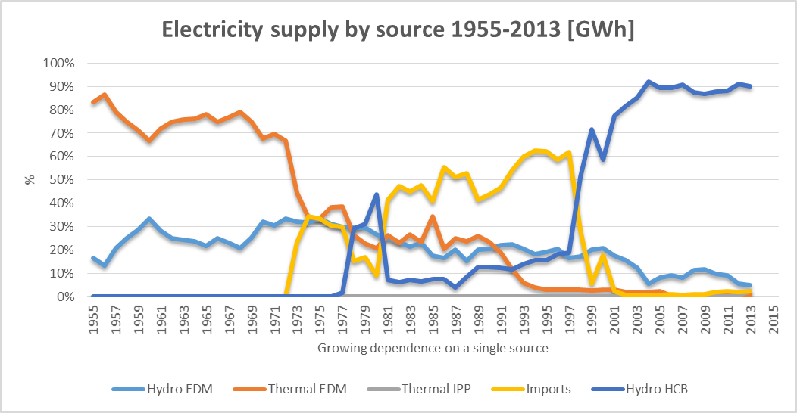
Concentration of Energy Supply by Source

Slide 16
Conclusion and Recommendations
More flexible application of regulations in place, stimulation of incentive to invest
Enhanced measures to combat network losses
Unbundling with extension of IPP generation including mini-grid PPP distribution
Tariff application based on greater cost-benefit assessment
short term outsourcing of transmission O &M

